Slide 1
Evolution of Natural Antisense Transcripts
(Or What I had been doing for the last 10 weeks)
Maurice Ling, James Ban, Xijin Ge

Slide 2
Evolution of Natural Antisense Transcripts
Supported by NIH grant (Project number: 5R01GM083226-03, PI: Xijin Ge)
Work in progress
What are natural antisense transcripts (NATs) and why are they important?
Aim 1: Identify tissue-specific NATs
Aim 2: Is the expression of NATs evolutionarily conserved?

Slide 3
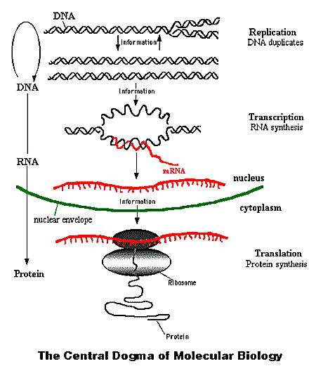
Background
Central dogma
DNA →RNA → peptide → proteins
Many possible controls
Accessibility of DNA
Expression of DNA (transcription)
Half-life of RNA
Processing of RNA
Coding of peptide (translation)
Activity of protein
Half-life of protein
Sense transcript = protein-coding gene
Antisense transcript = expressed complement of the protein-coding gene
Antisense transcript can bind to sense transcript and “interfere” with
Half-life of RNA
Processing of RNA
Coding of peptide (translation)

Slide 4
Background
NATs may be a p(layer) in the regulation of protein expression
NAT is not isolated events
20-30% of human genes have NATs (Lehner et al., 2002)
Involvement in diseases
α-thalassemia (Zhang et al., 2006), hypertension (Michael et al., 2011), Huntington’s (Chung et al., 2011), immune disorders (Hatzoglou et al., 2002), Alzheimer’s (Faghihi et al., 2010)

Slide 5
Background
Extend of regulation vs transcriptional noise is still unknown (Conley and Jordan, 2011).
We know more about protein-coding genes
Higher sequence similarity → Similar expression patterns (Jordan et al., 2005)
Gene expression between mouse-human homologs are more correlated than random pairs
Homologs are genes that descent from a common ancestral DNA sequence

Slide 6
Hypotheses
NATs are actively regulated; thus, not transcriptional noise.
Do they follow the same expression patterns with respect to protein-coding genes?
Higher sequence similarity → Similar expression patterns
James ➔ examines protein-coding gene expression
Identify tissue-specific / novel NATs

Slide 7
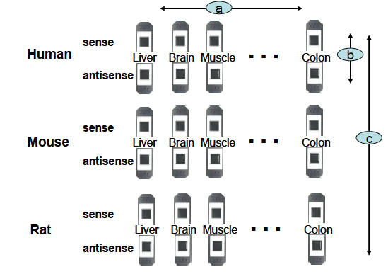
Set Up

Slide 8
Is the expression of NATs evolutionarily conserved?
Gene level analysis, then exon level analysis
One gene has one or more exons
Compare the correlation distribution of homologous pairs with random (non-homologous pairs)
Gene: HomoloGene (protein) → Gene accession → microarray probes

Slide 9
Random vs antisense
Human/Mouse, p = 1.49e-139
Human/Rat, p = 3.11e-73
Mouse/Rat, p < 1e-140
Human-Mouse-Rat ancestor = 87 million years ago
Mouse-Rat = 16 million years ago
Source: Bourque et al., 2004

Slide 10
Story so far
Expression of homologous antisense genes is statistically higher than non-homologous genes
Higher sequence similarity → Similar expression patterns (Jordan et al., 2005)
Exon level
Expression of homologous antisense exons is statistically higher than non-homologous exons
Correlation is directly proportional to identity

Slide 11
Analyzing Antisense Exons
There is HomoloGene for homologous genes but no such thing for exons
Download human, mouse, rat exon data from UC Santa Clara
Create my own BLAST database and do pairwise BLAST (Needleman-Wunsch takes 1 millenium on 3 processors)
Map to probe by genome coordinates using chromosome, start and end positions
Remove cases where both orthologs have expression lower than 4.35 (average of all data) as noise

Slide 13
Statistical Tests
One-way ANOVA on identity-striated correlations
Human/mouse orthologs, p = 1.27e-14
Human/rat orthologs, p = 2.38e-20
Mouse/rat orthologs, p = 1.90e-87
Visual observation → trends are as expected
Correlation is directly proportional to identity

Slide 14
Hypotheses so far
NATs are actively regulated; thus, not transcriptional noise.
Expression of homologous antisense genes is statistically higher than non-homologous genes
Correlation is directly proportional to identity
Suggests that NATs are actively regulated
Identify tissue-specific / novel NATs

Slide 15
Identify Tissue-Specific NATs
BLAST against RefSeq database
Empirical criteria
Tissue-specific NATs
Tissue-specific NATs that are not known genes
All the probes
Z-score > 2
g1/g2 > 2
BLAST against EST database
Experimental verification
Novel tissue-specific NATs

Slide 16
10 Tissue-specific probes from rat (not found in RefSeq)

Slide 17
Example of homologous embryo-specific NAT
100% identity
Criteria:
Z-score > 2
g1/g2 > 2

Slide 19
Threshold
Expectation < 1e-9, BLAST against RefSeq
Identity < 80%, BLAST against EST database

Slide 20
Tissue-Specific Homologous Exons for Human and Rat

Slide 21
Hypotheses so far
NATs are actively regulated; thus, not transcriptional noise.
Expression of homologous antisense genes is statistically higher than non-homologous genes
Correlation is directly proportional to identity
Suggests that NATs are actively regulated
Identify tissue-specific / novel NATs
543 tissue-specific and novel NATs identified – 150 (rat), 192 (mouse), 201(human)

Slide 22
Future Work
Experimentally verify a few tissue-specific NATs
Comparing othologous antisense transcripts with orthologous sense transcripts
Are othologous antisense transcripts as rigorously regulated orthologous sense transcripts?
Speculatively, I don’t think so
Biological significance of NATs – their individual regulation and roles.

